Slide 1
Project Implementation
Students: Matt Raporte and Greg Potter
Customer: Professor Huang, Professor Chuah

Slide 2

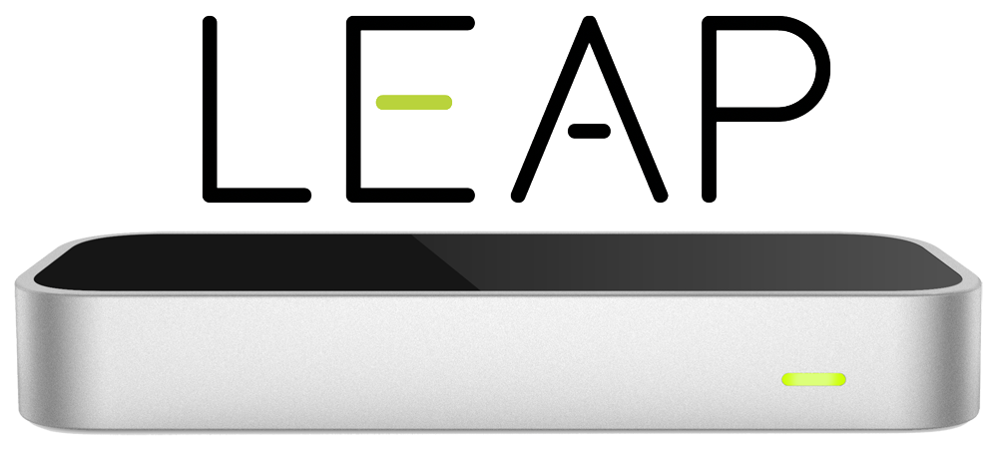
in case you missed our last 3 presentations..

Slide 3
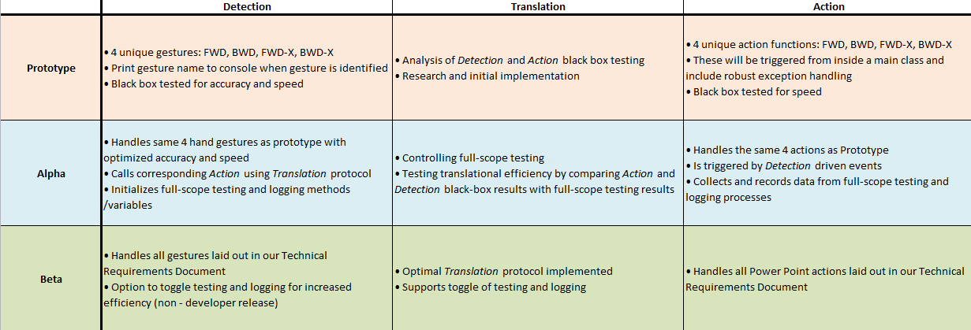
}
base scope

Slide 4
Detection
Base level gestures implemented and tested
•How?
•Issues?
70$
Notes:
How? Listener, Controller, Listener:onFrame(), frame.gestures() … normal directions/rotational direction.. to distinguish fwd from bwd, fwd-x from bwd-x.. then swept angle to determine the “X”
Issues? Latency/False detection, incapability extending gesture class. Can we limit how much data the hardware reads each frame and only read the relevant info in order to improve speed? NOPE

Slide 5
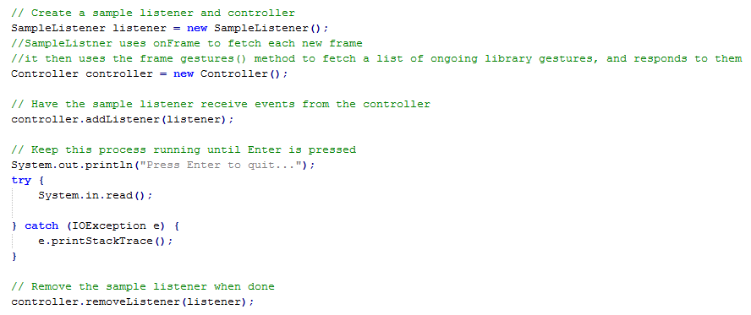
Detection

Slide 6
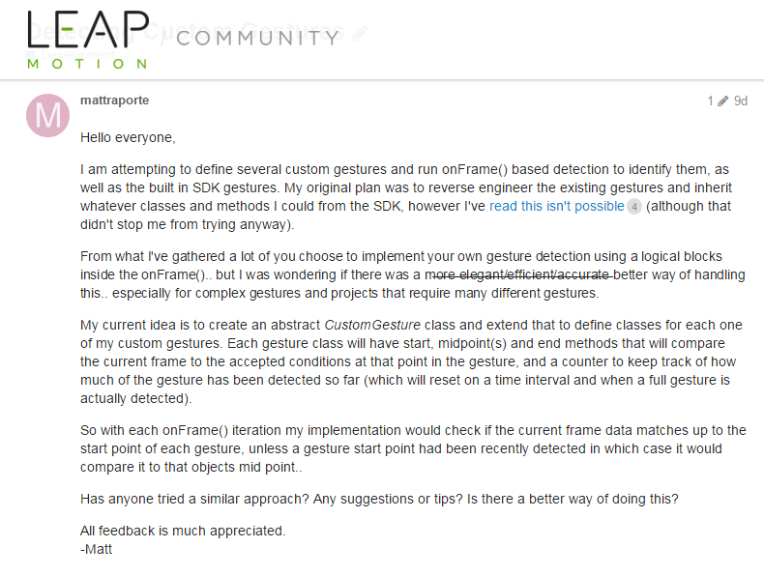
Detection: What next?
Need to implement custom gestures.. first approach (why?):
Problems with this?
Notes:
create an abstract CustomGesture class and extend that to define classes for each one of my custom gestures. Each gesture class will have start, midpoint(s) and end methods that will compare the current frame to the accepted conditions at that point in the gesture, and a counter to keep track of how much of the gesture has been detected so far (which will reset on a time interval and when a full gesture is actually detected).
So with each onFrame() iteration my implementation would check if the current frame data matches up to the start point of each gesture, unless a gesture start point had been recently detected in which case it would compare it to that objects mid point..

Slide 7
Detection: Moving on..
Two implementation choices:
Logical: has to be more carefully defined, extensively tested and take into account hardware limitations
Algorithmic: implement 1$ unistroke recognizer - could significantly boost performance and accuracy, but it would be difficult to adapt to 3D and might actually create more overhead because it’s designed for more complex gestures.

Slide 8
Detection: Currently
“Clap” and “Make Fist” currently working in straight-forward logical architecture
•Clap:
-Normal palm vectors face each other
-Hands approach each other frame by frame (distance shrinks)
-Start point significantly far apart, end point significantly close together.
•Make Fist:
-if((lastFrame.fingersPresent()==5)&&(thisFrame.fingersPresent()==0)&&(palmNormal is facing down))
-Issues with finger detection

Slide 9
80% of “base”

Slide 10
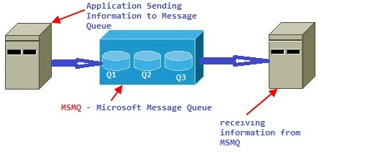
Translation
Working queue for sending commands to the Action phase
Check to make sure that commands were in the last 2 seconds, otherwise throw them away
Planning to use MsmqJava library to connect to the queue

Slide 11

Action
Currently have working slide control. Built a simple UI until Detection is
Runs as a standalone application that connects to PowerPoint
Listens to the queue and passes along commands to Application

Slide 12
80% of “base”
85% of “base”
90% of “base”

